Slide 1
Hello Welcome!
Lecture Week One

Slide 3
This is Web Technologies
4NCC01- Autumn 2022
Notes:
ISA is about internet and web technologies.

Slide 4

Lecturer. Designer.
Pravash Karki
18+ years in tech

Slide 5








What the heck did you Build?

Slide 6
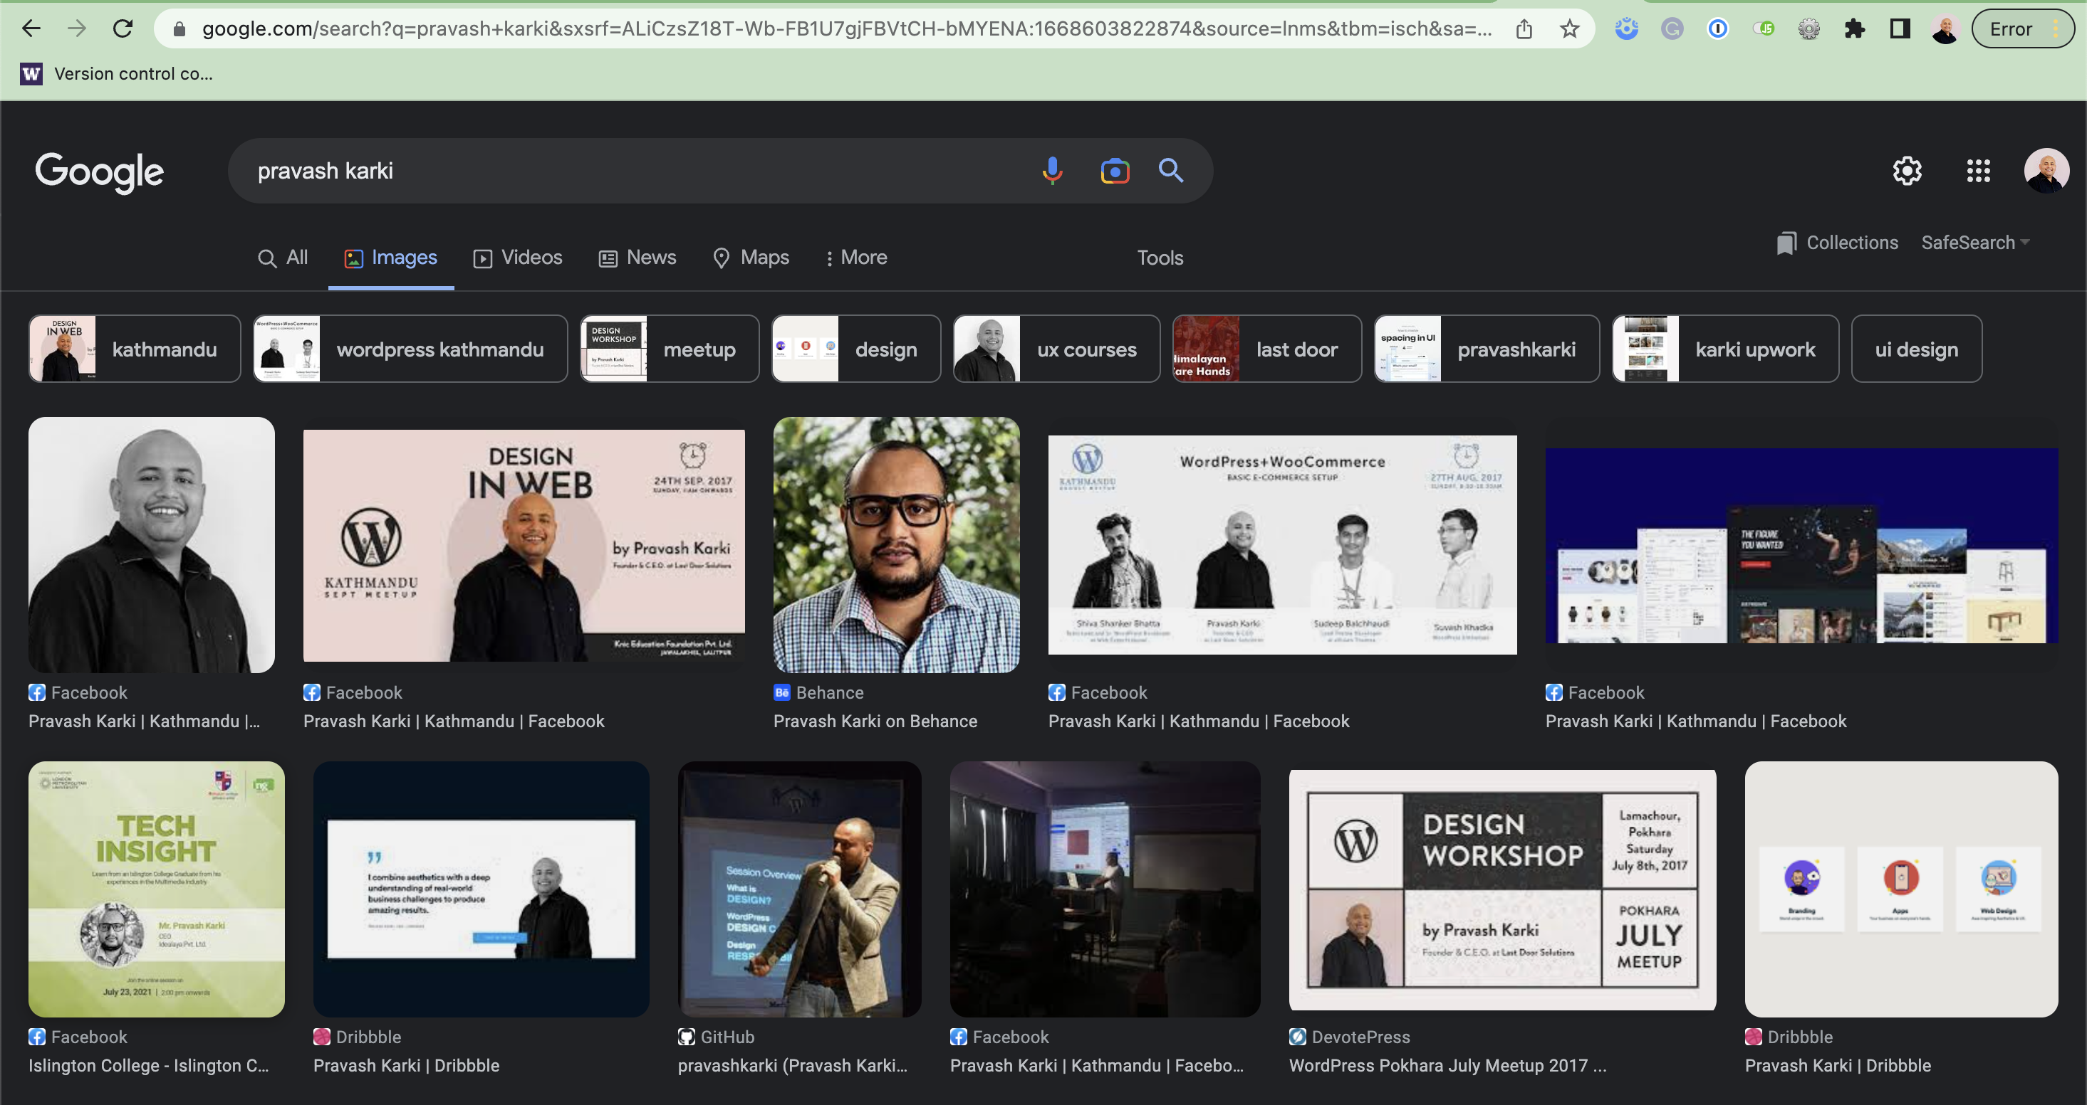

Slide 7
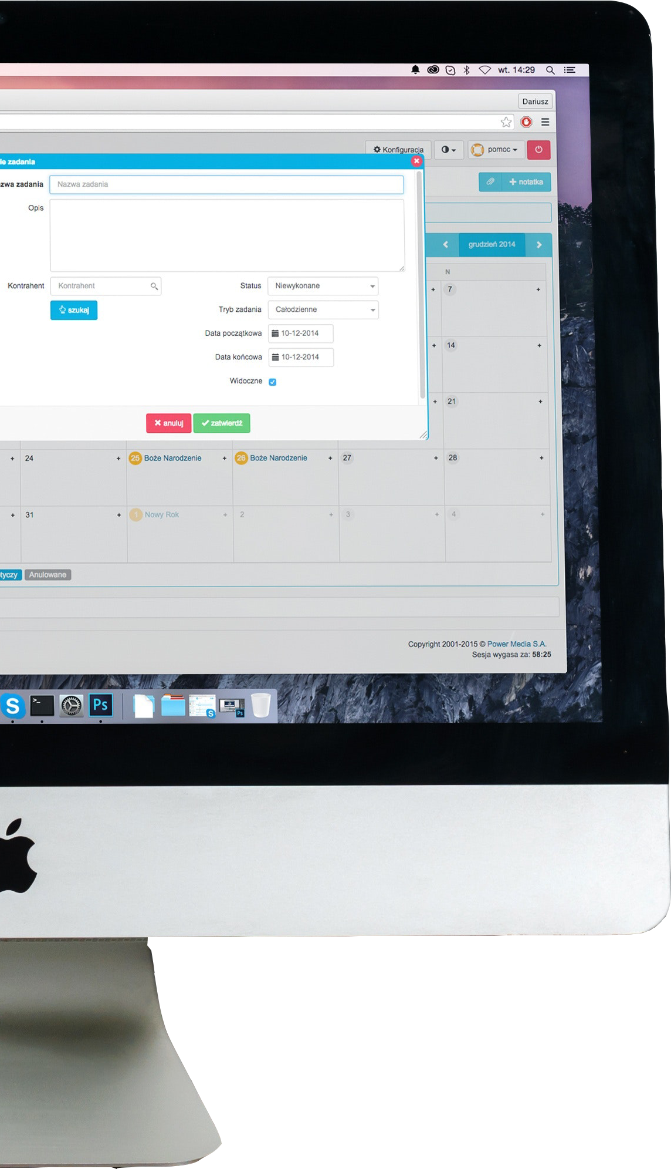

Introduction Web Technologies Team
4NCC01
1. Pravash Karki (Module Leader)
2. Jenny Rajak
3. Nerisha Shrestha
4. Yojana Ghimire
5. Jesmi Rajak
FACILITATORS

Slide 8
Module’s Agenda
Understand: Internet and cloud-based software architecture, tools, and techniques.
U
Design: Architecture based on requirements and constraints.
D
Implement: Portfolio website using appropriate architecture and technology.
I

Slide 9
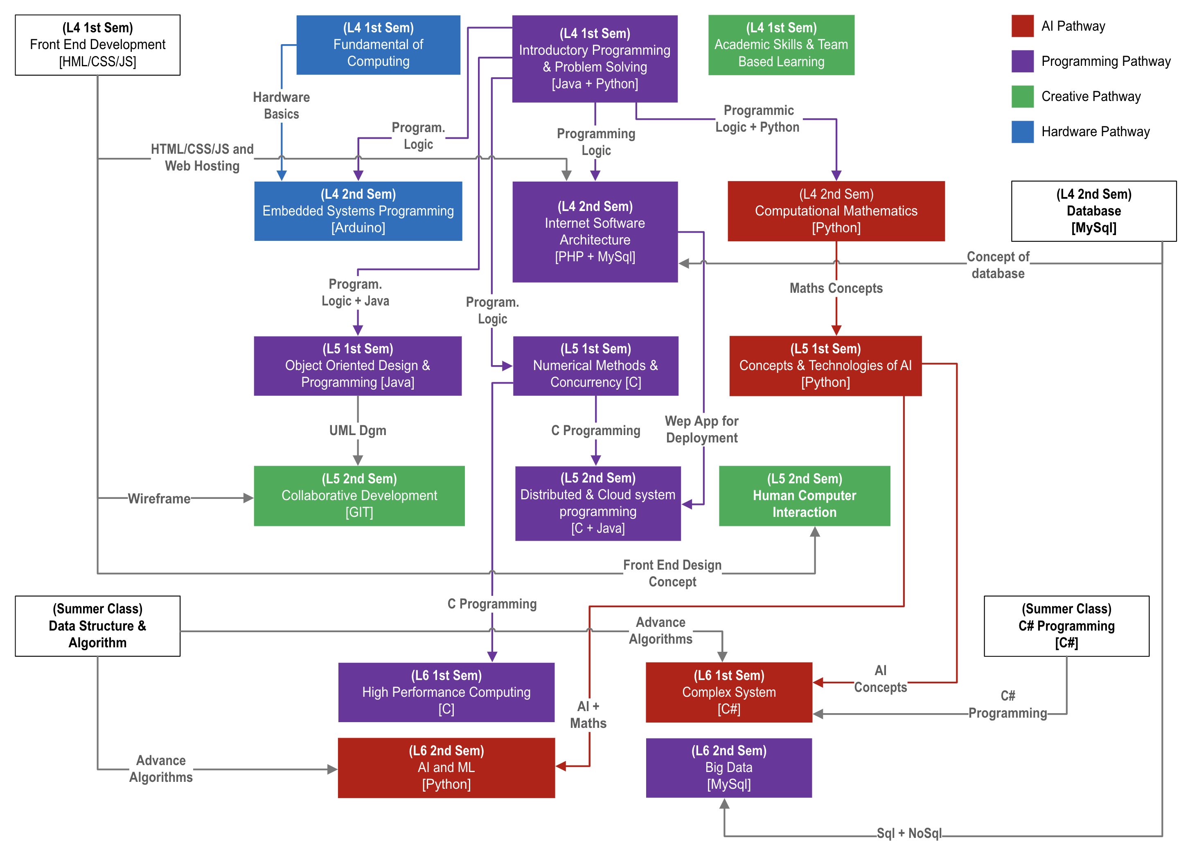
Course Flow

Slide 10
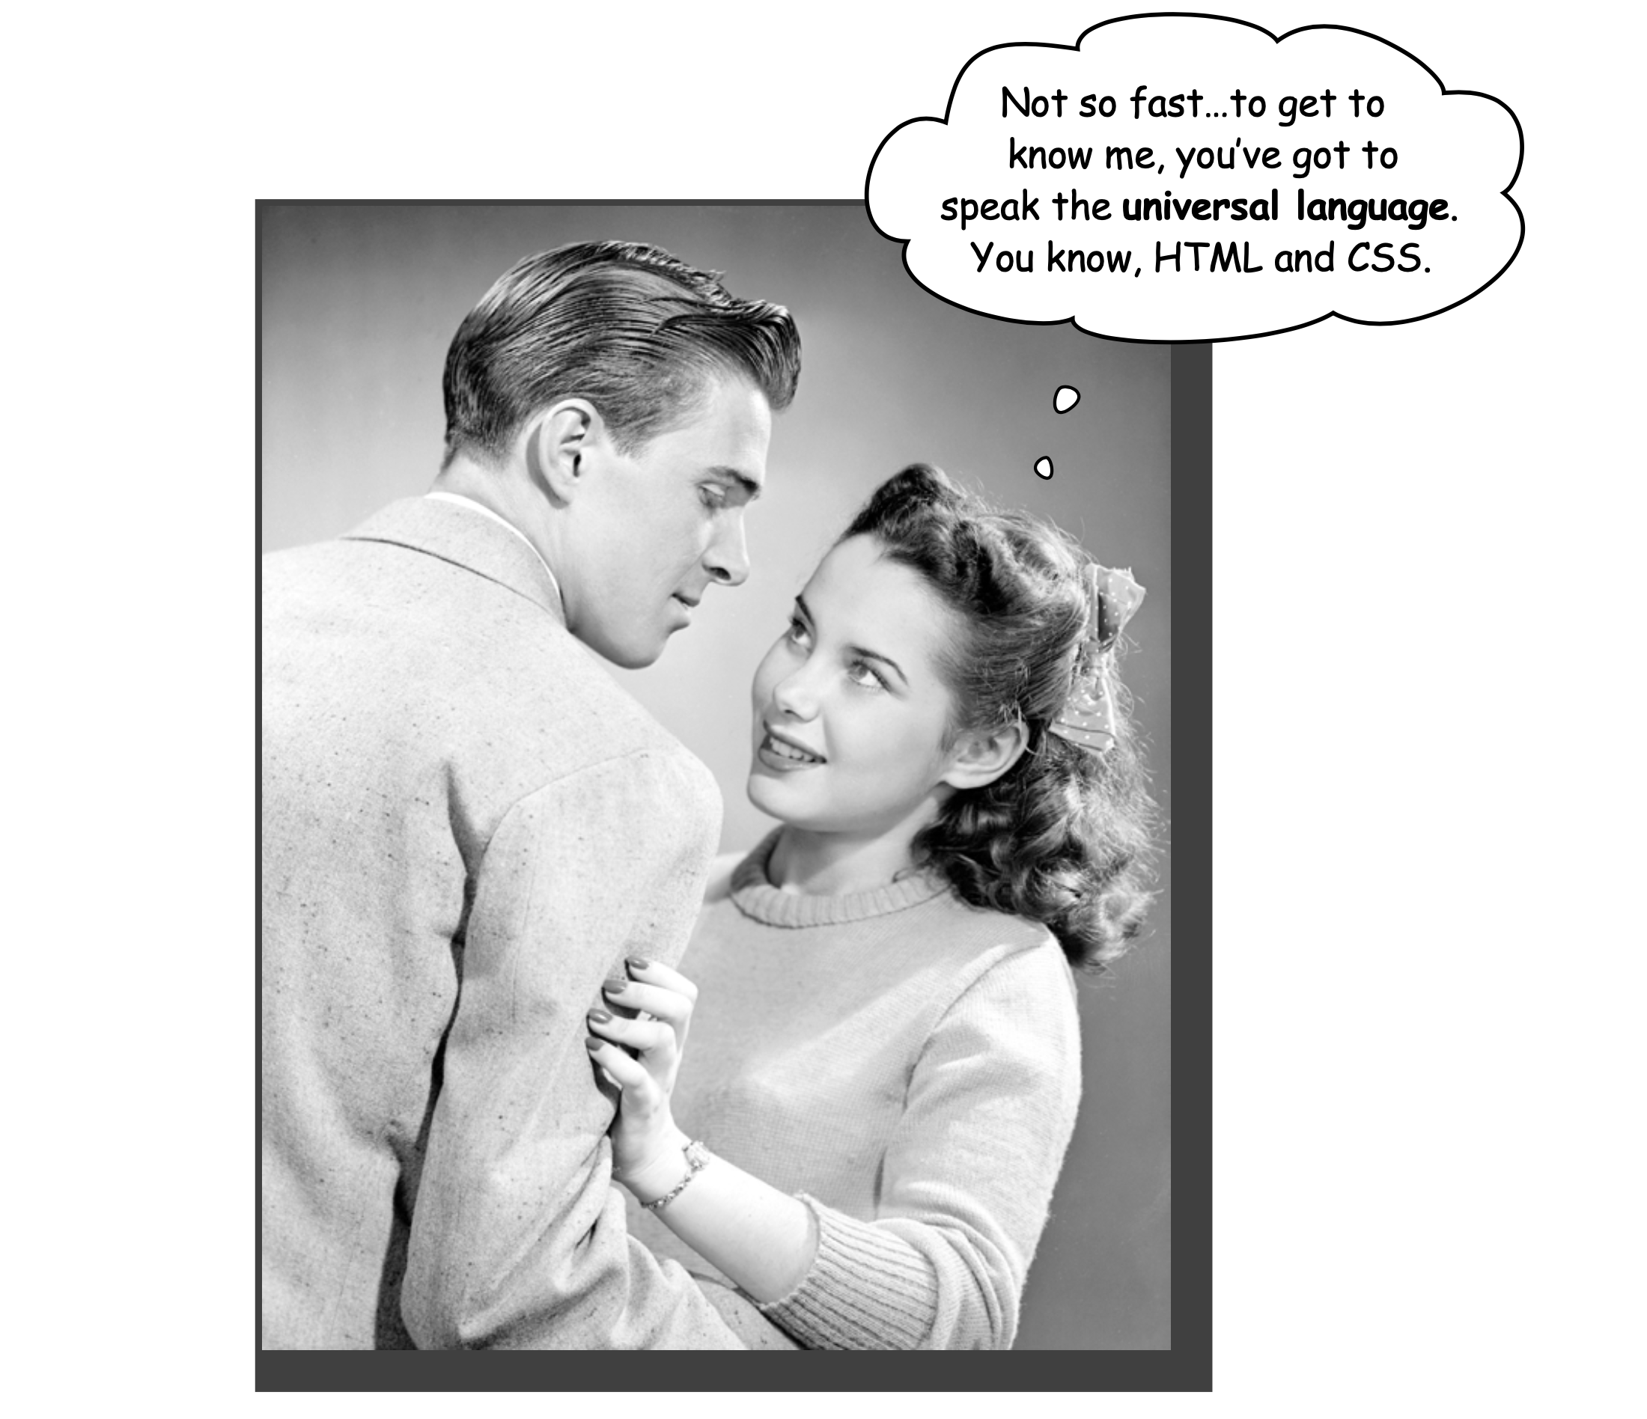
Getting to know HTML
The Language of the Web

Slide 11
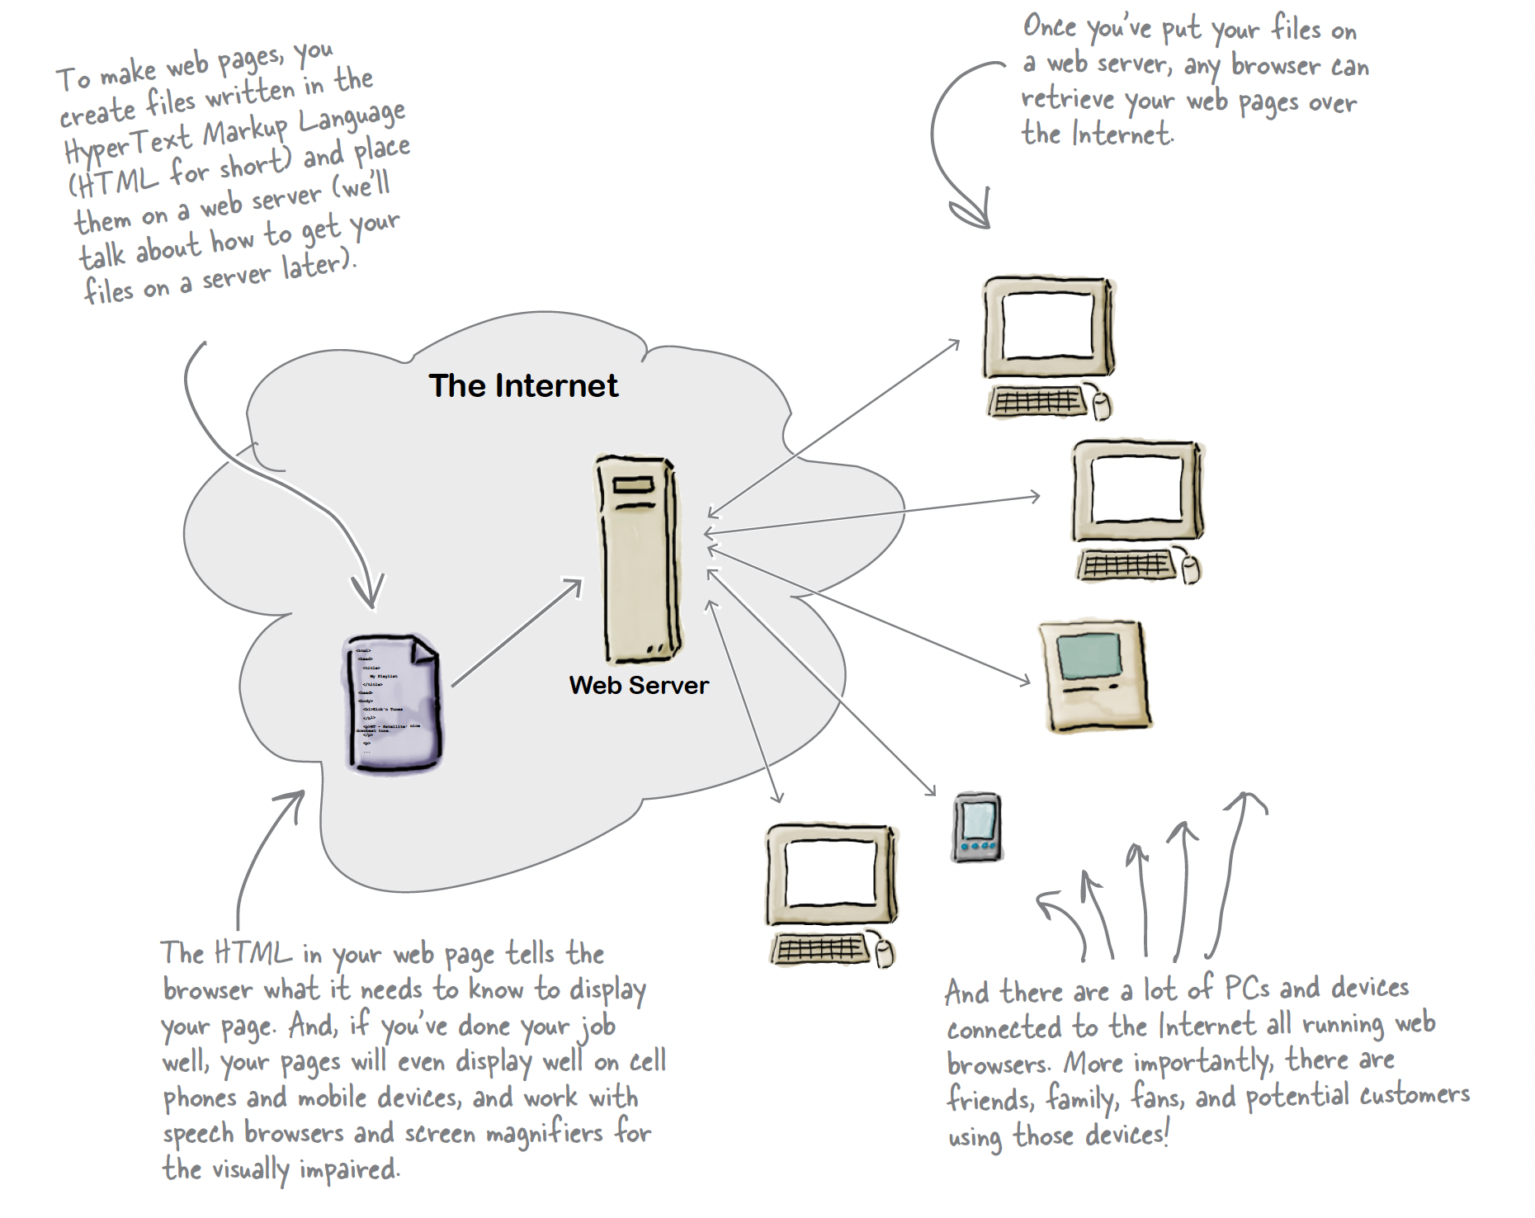
The
Internet

Slide 12
What does the web Server do?

Slide 13
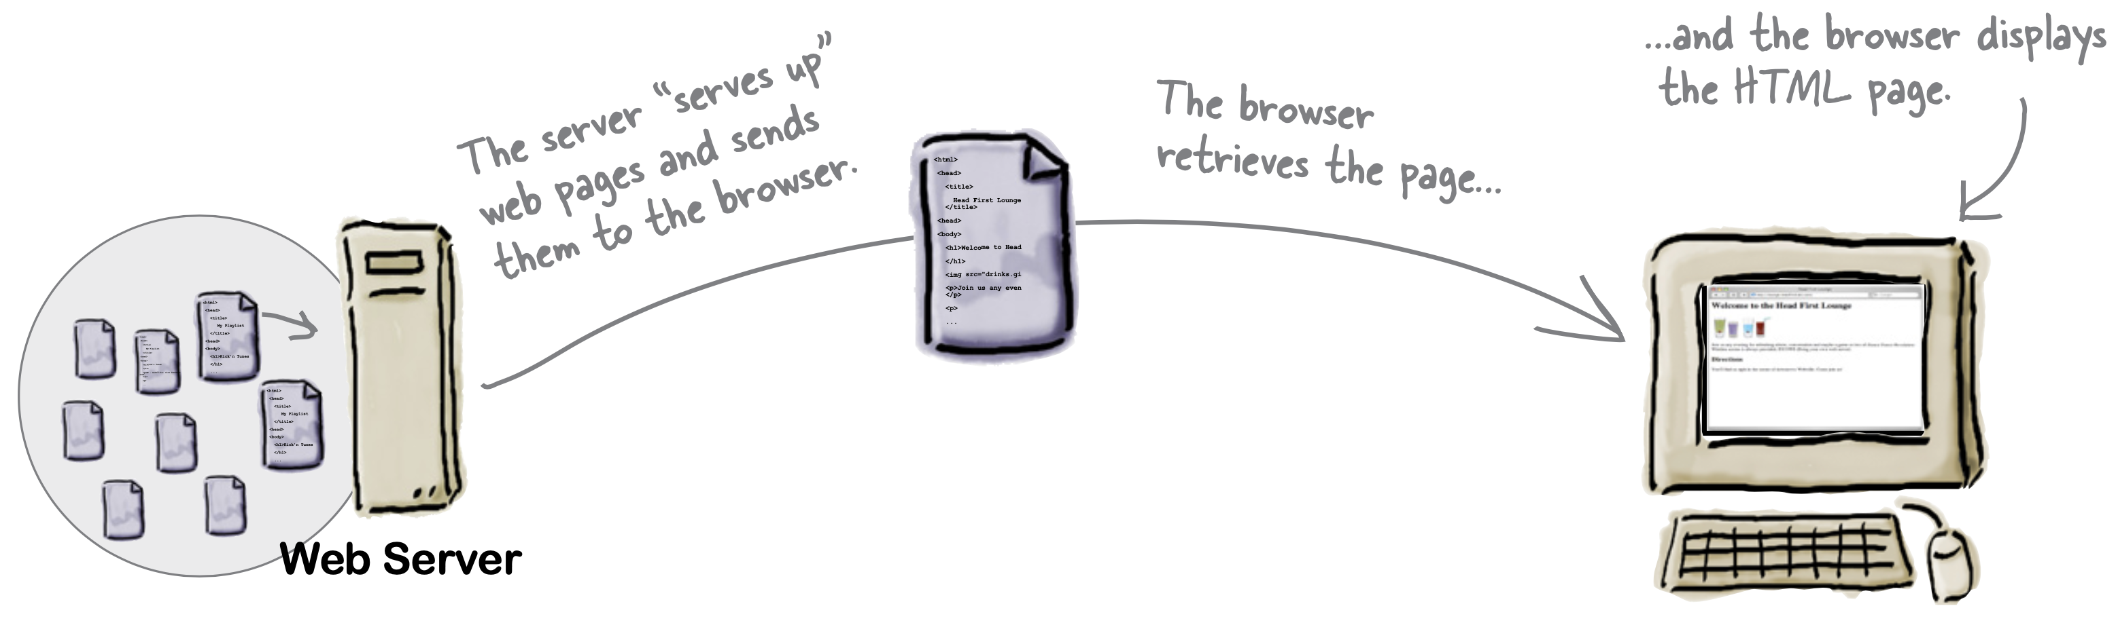
What does the web browser do?

Slide 14
What does the web browser do?

Slide 15
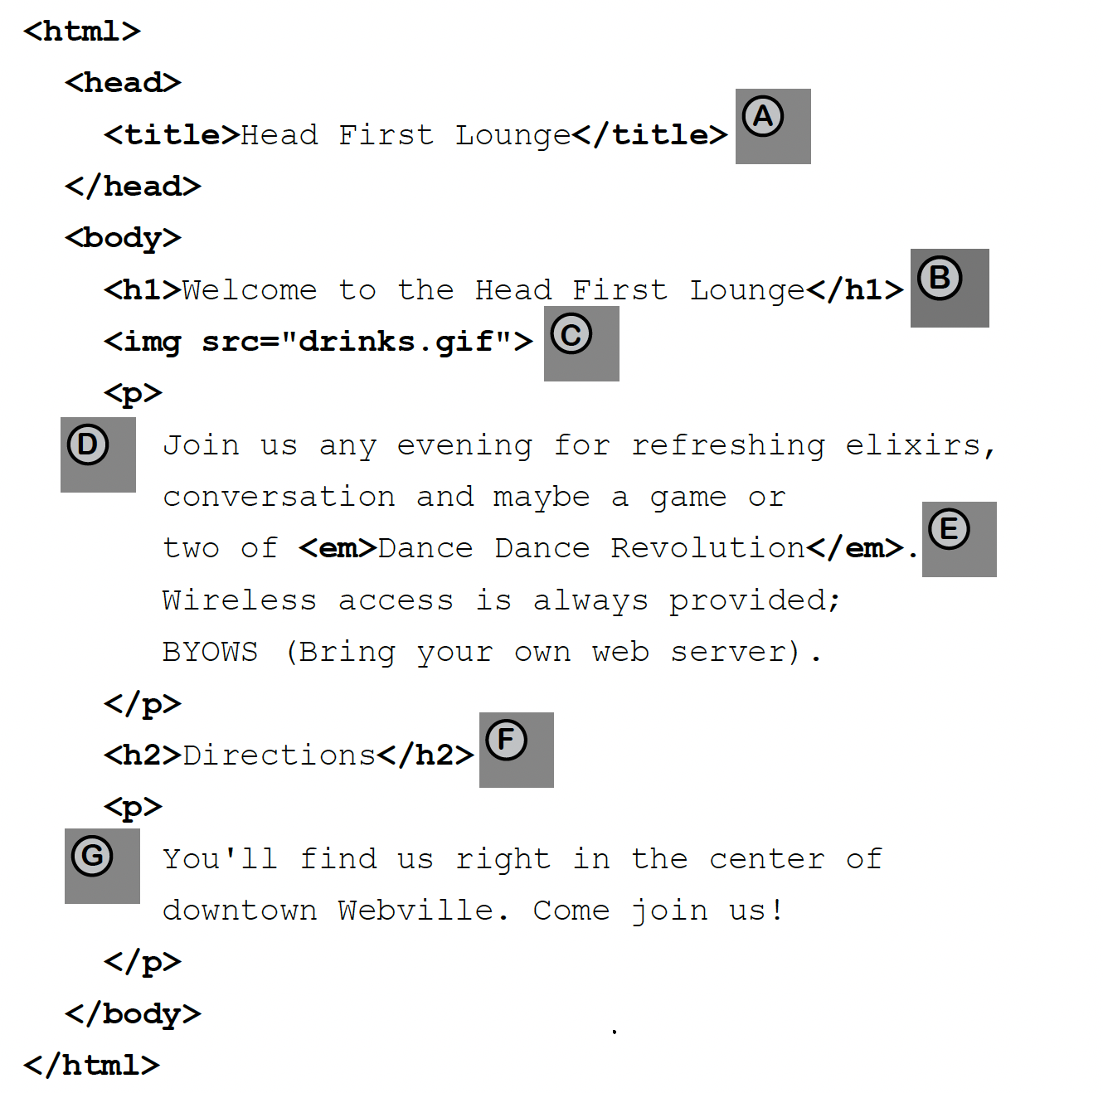
What you write (the html)

Slide 16
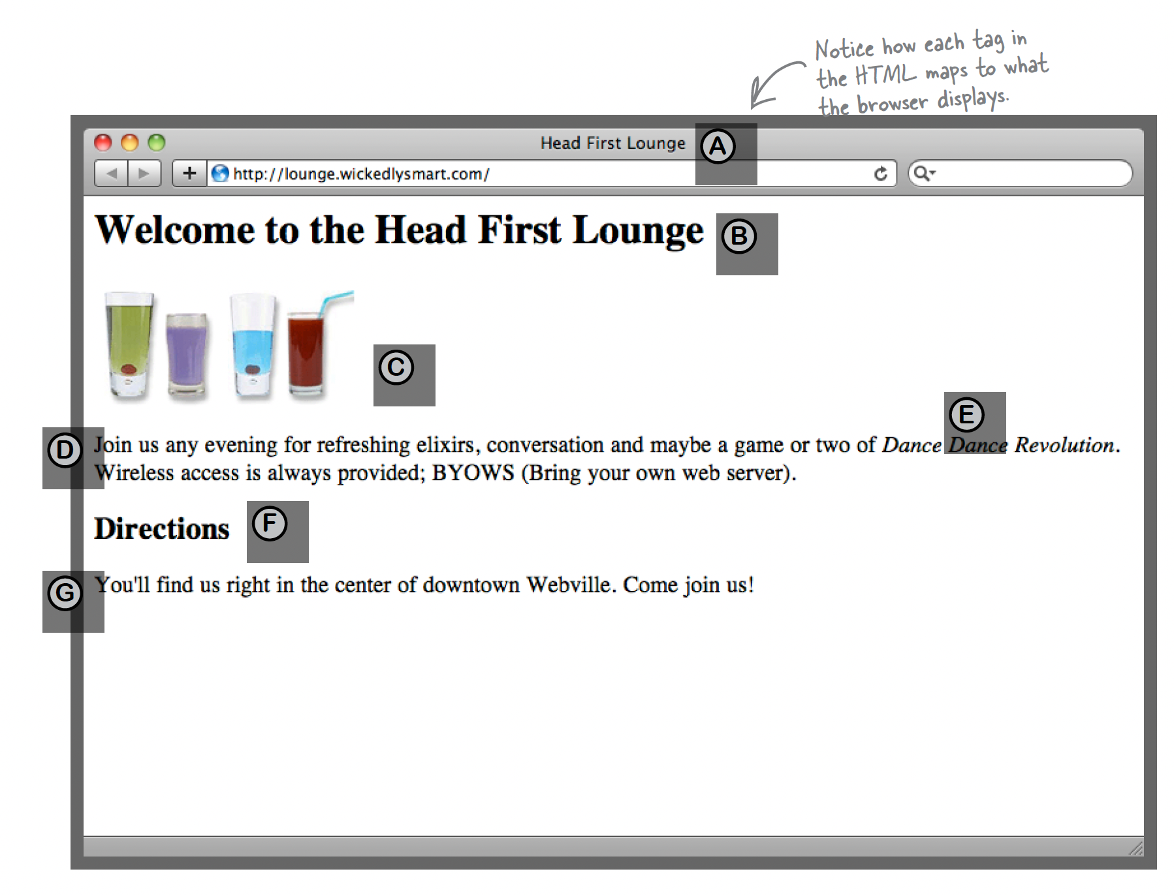
What the browser create

Slide 17
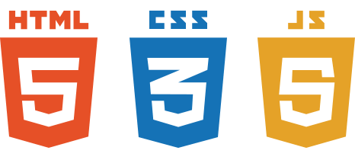
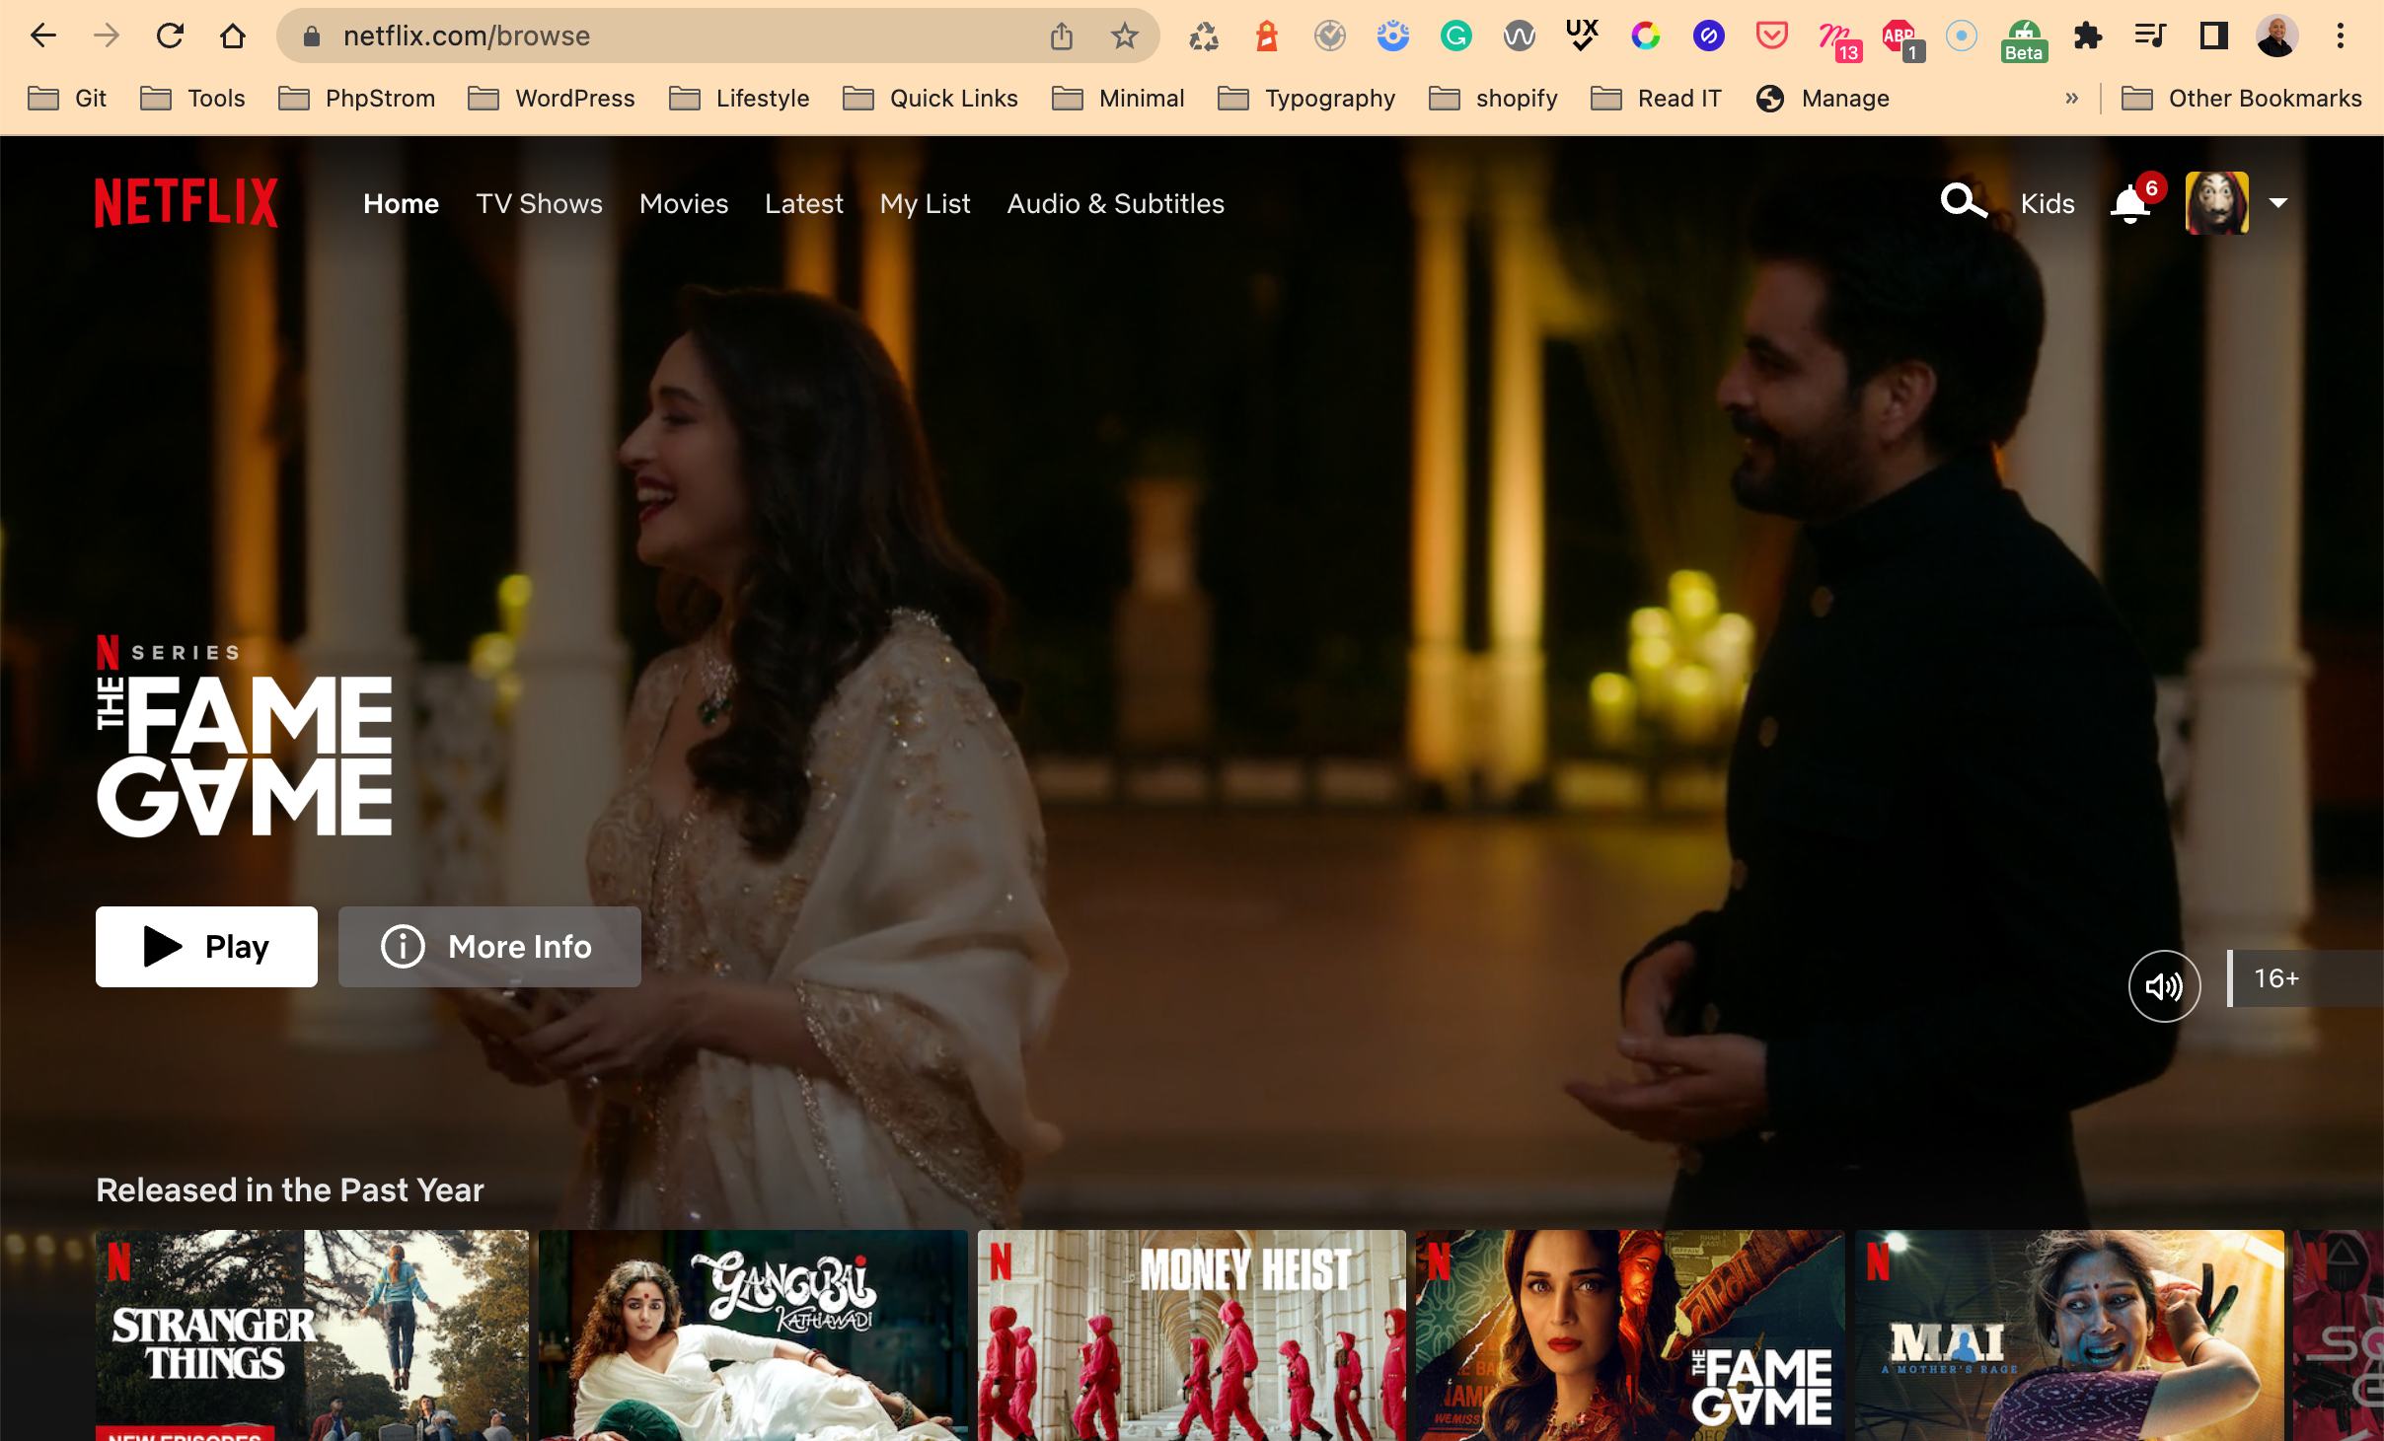
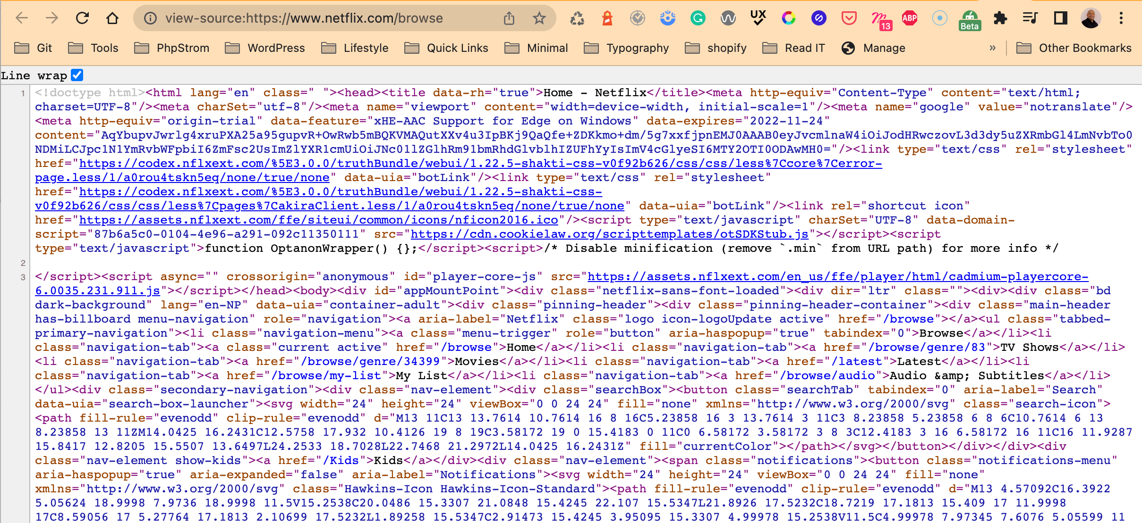

How complex the html code can be?
Notes:
Client-side is basically from where you access the server.
A user uses client-side software such as Google Chrome to send and receive requests to and from the server.
The request received can be in a form of HTML, content or JSON APIs.
Client-side or front end scripting is a technique or languages that runs in the client-side software.
Some of the examples of client side languages are HTML and JavaScript.

Slide 18
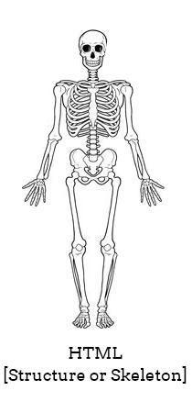
What are Web Pages made of?
HTML (Hyper Text Markup Language)
HTML are Structure or Skeleton
Notes:
This allows you to write structural/markup codes for your webpage.
Creates a structure/skeleton for your webpage.
Without styling and interaction, HTML does not look useful.
HTML5 is a semantic markup language.
The language has tags, elements and attributes.

Slide 19
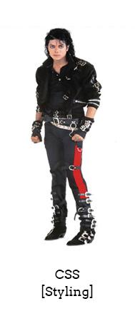
What are Web Pages made of?
CSS (Cascading Style Sheets)
CSS is Styling
Notes:
This allows you to add styling to your HTML structure.
The CSS has selectors, properties and values.
Styling is done by targeting the given selector.
CSS Selectors can either be element, classes, ids or attributes.
CSS is used give layouts to your structure using the Box Model.

Slide 20
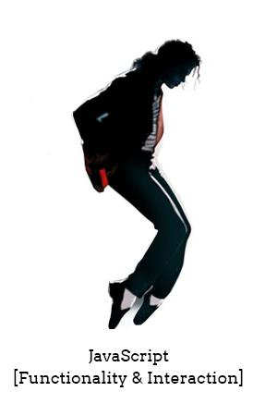
What are Web Pages made of?
Javascript
JS is Functionality & Interaction
Notes:
This allows you to add some functionality and interaction to your web application.
JavaScript is a scripting language, which means you don’t have to render or compile it like Java.
It is a client side scripting language. It runs on browser itself.
JavaScript itself is based on objects and prototypes.

Slide 21
Writing your first html page...
Document type declaration.
<!DOCTYPE html>
Notes:
First you will need a text-editor like notepad, notepad++ or code-editors like “Sublime text”, “Dreamweaver”, “Atom”, etc.
Your every html document needs to start with a DOCTYPE declaration.
DOCTYPE declaration is a way of telling your browser which version of html is your document following.

Slide 22
The head
<head> <title>Page Name </title> </head>
And body
<body>
<h1>Hello Class!</h1>
<p> elements inside the “body’ element is visible to the users via the web browsers.
</body>
Notes:
An html document is divided into two sections enclosed by the <html> tag itself. The “head” and “body”.
The <head> element is a container for metadata (data about data). The following tags describes metadata: <title>, <style>, <meta>, <link> and <script>.
The <body> element is where all your other html elements (tags and contents) go.
The tags inside the <head> element is not shown where as elements inside the <body> element is visible to the users via the web browsers.

Slide 23
Let's put it all together
<!DOCTYPE html> <html> <head> <!--These will not be shown in the browser--> <meta charset=“utf-8”> <title>Hello World!!</title> </head> <body> <!--Only this part will be shown in the browser--> <h1>Hello Class</h1> </body> </html>
Notes:
Note: All your html documents must be saved with a “.html” extension.

Slide 24
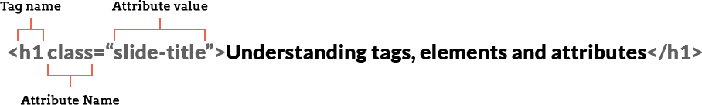
<tag> attribute=“value”>

Slide 25
<tags> are…
Structure that surround content <start></start>
exception
<br><img> don’t need closing
Notes:
Tags are the basic structure of an HTML document which surrounds contents and apply meaning to it.
Tags tend to not do much more than mark the beginning and end of an element. Example: <h1></h1>
There are some tags that do not need closing. Such tags does not wrap any content between them. Example: <br>, <img>

Slide 26
Attributes
Notes:
Attributes defines additional information to an element.
Attributes are always written inside the opening tags and sits as a key/value pair.
An attribute key can have multiple value, each separated by a “space [ ]”
A tag can also have any number of space separated attribute of key/value pair.
Attributes are system defined, however since the inception of HTML5.

Slide 27
let’s take a
<br>

Slide 28
Web Page Construction

Slide 29
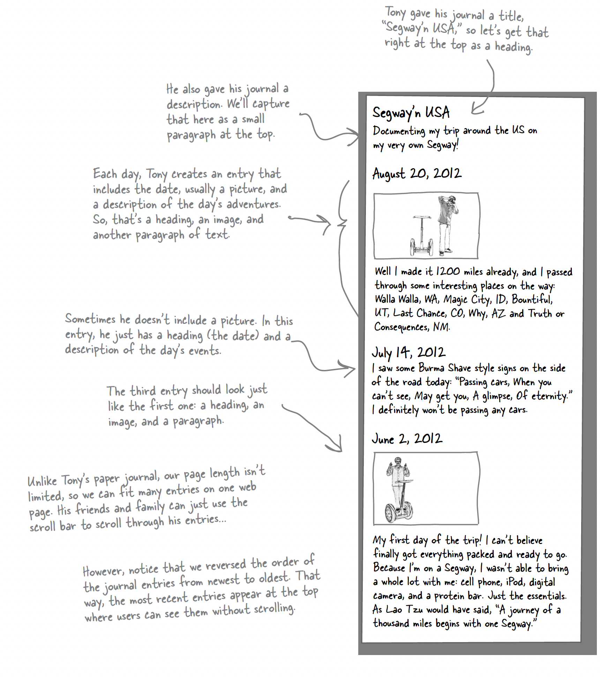
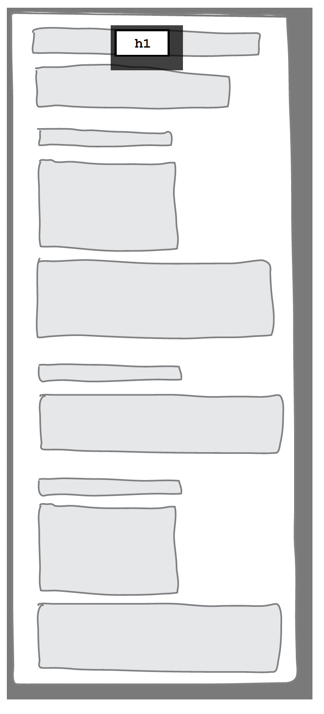
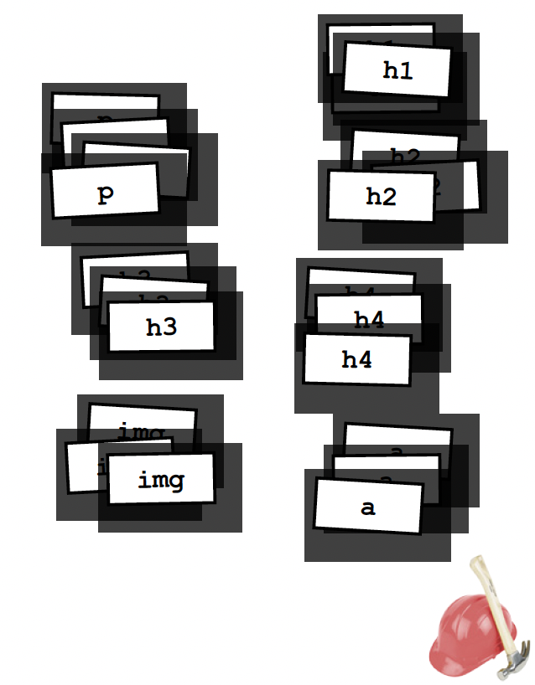
Making a rough sketch

Slide 30
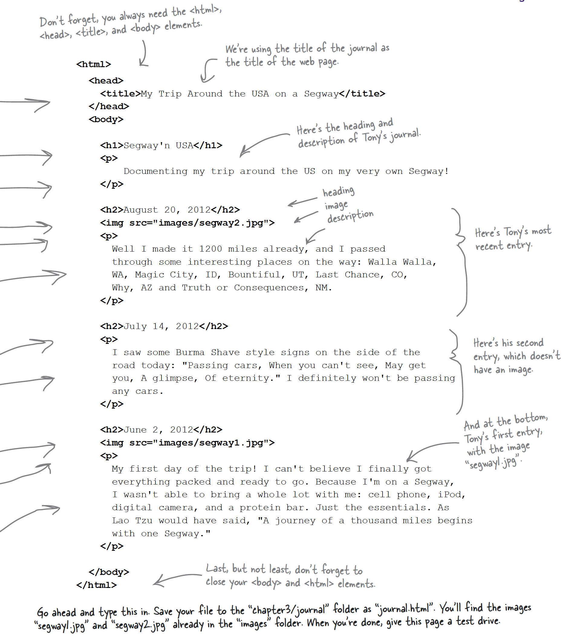
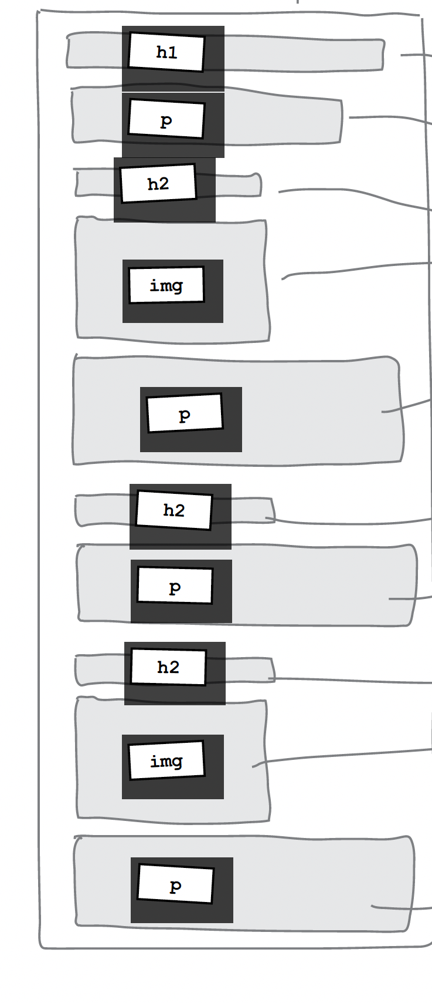
Turning the outline into a web page

Slide 31
Ok, I understand how the web and html
works… but where to I write the actual html?

Slide 32
IDE An integrated development environment

Slide 33
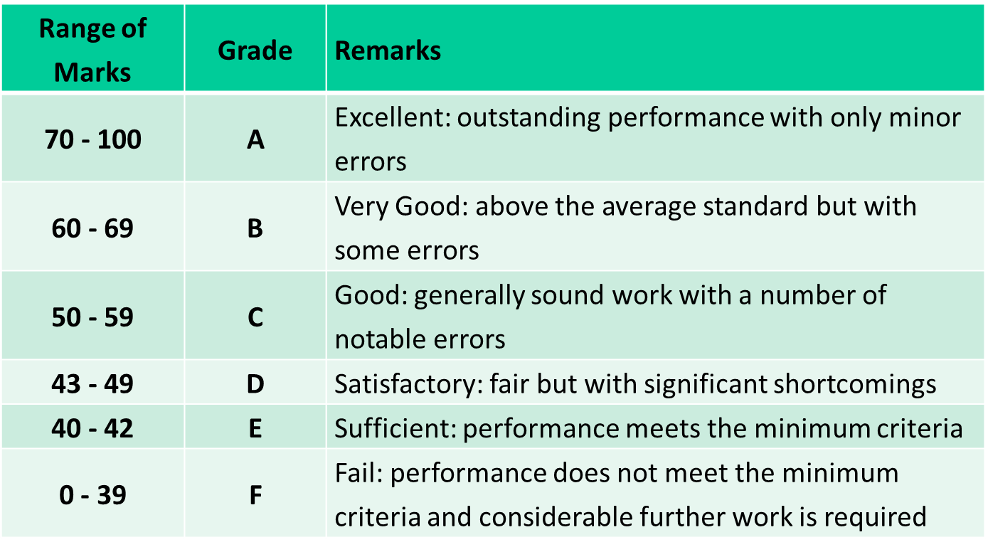
Module Grading UK
Notes:
Module Grading standards in the U.K

Slide 34
Want to Learn more?
HTML5 Doctor
HTML5: W3C Schools
HTML5: Tutorial Points

Slide 35
Thank you!

